Slide 1


Slide 2
Real-Time Public Transport Tracking for Small Cities
Bringing transit visibility to cities that need an affordable solution
Section : 13
Project : Group -2

Slide 3
Team Members
KH
K. V. Harshini
2620030195
NK
N. Keerthi Chowdary
2620030196
KA
K. Anudeep Rao
2620030283
VR
V. Radhakrishna
2620030317
EY
E. Yaswanth Chowdary
2620030377
VS
V. Sri Bhavana
2620080038
Under the guidance of Dr. G. Sudhakar
Department of Computer Science & Engineering

Slide 4
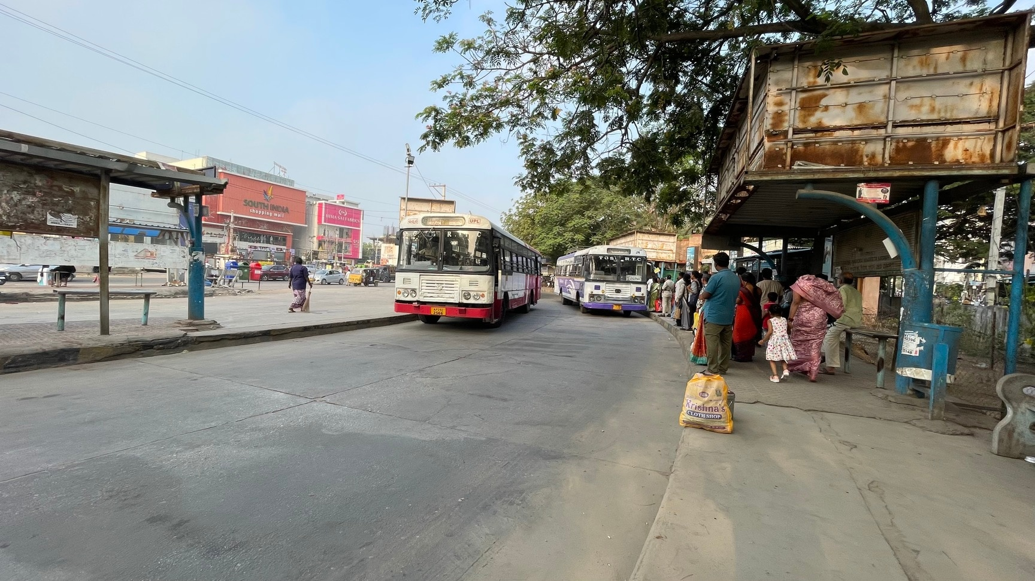

Slide 5
Vision and Mission
VISION
Every bus in every small city, visible to the people who depend on it.
Simple. Affordable. Dependable.
MISSION
1
Build a low-cost tracker from a driver smartphone or a simple GPS device
2
Give passengers a live map and a useful arrival estimate
3
Give operators a clear view of active buses and delays
4
Publish open, reusable data (GTFS-Realtime) for the wider ecosystem

Slide 6
Problem Statement
1
2
3
No live location
Passengers cannot easily know where their bus is or when it will arrive.
Uncertain journeys
People leave early to avoid missing buses and may wait unnecessarily.
Limited fleet visibility
Operators have little real-time information about delays and vehicle status.
CORE PROBLEM STATEMENT
Design a low-cost tracking system that shows live bus positions and useful arrival estimates without expensive per-vehicle licences or complex infrastructure.
How might we help passengers in small cities see bus locations and estimate arrivals using affordable technology?

Slide 7
Research / Facts / Market & Industry Study
ENABLING TECHNOLOGY (OPEN & LOW-COST)
MARKET & INDUSTRY GAP
GTFS-Realtime
Open standard for live transit feeds
Small cities often run bus services with no live location for passengers
Full intelligent transport systems need costly infrastructure and sensors
Operators rarely have dedicated IT staff to run complex systems
Passengers may have limited mobile data, so the app must stay light
MQTT
Lightweight messaging for small GPS packets
PostGIS
Route matching and distance queries
Leaflet + OSM
Free, open passenger map

Slide 8
Target User - Customer
P
Passengers
D
Drivers
O
Operators
Want to know where the bus is
Need an estimated arrival time
May have limited mobile data
Need a simple interface
Should not be distracted while driving
Need a device that is easy to use
Need to see active buses and delays
Need affordable maintenance
May not have dedicated IT staff
Insight: the system must be simple, affordable and dependable, not just technically advanced.

Slide 9
Competitors / Benchmarks
Approach
Cost
Strength / Risk
Decision
Driver phone + GPS
Low cost
Simple pilot
Selected starting concept
Dedicated SIM tracker
Moderate hardware cost
Reliable device option
Possible later upgrade
Crowdsourced tracking
Low hardware cost
Depends on participation
Not reliable as the only source
Full ITS deployment
High cost
Complex infrastructure
Outside initial scope
Voting criteria: affordability • ease of deployment • maintenance • passenger usefulness • scalability

Slide 10
Risks and Gap
RISK
HOW WE HANDLE IT
ETA accuracy may vary with traffic and stops
Match GPS to the route, add dwell time, and measure ETA error in the pilot
Network loss or limited mobile data
Send tiny MQTT messages and show last-seen time when data is stale
Driver distraction or low adoption
One-tap start; no interaction needed while driving
Crowdsourcing depends on participation
Use it only as a supplement, never as the sole source
The gap: no affordable, simple, open option sits between having no tracking and a full ITS deployment.

Slide 11
Concept/Idea/Prototype/Product/Solution
1
2
3
4
Capture GPS
Latitude, longitude and speed from a phone or tracker.
Send data
MQTT sends small location messages to the server.
Estimate arrival
Match GPS to the route; add distance and dwell time.
Share updates
Live map, operator dashboard and GTFS-Realtime output.
PROPOSED CONCEPT · RAPID ESTIMATION
ETA ≈ (remaining route distance ÷ effective speed) + expected dwell time at intermediate stops
Start with a driver smartphone or low-cost GPS tracker, MQTT data transfer, a simple backend and a passenger map.

Slide 12
Images/Storyboard/Architecture
Data source
Driver phone or low-cost GPS tracker
MQTT broker
Receives small location messages
Backend
Route matching + ETA (PostGIS)
Passenger map
Operator dashboard
GTFS-Realtime feed
PROTOTYPE SCREENS (WIREFRAME)
A
Passenger view
B
Operator view
C
Prototype test
Live map, bus marker, route and next-stop ETA.
List of active buses, last update time and delay alerts.
Check readability, location freshness and ease of finding a route.
CITY BUS · LIVE TRACKING | Route 12 · Next stop: Market Road · ETA: -- min

Slide 13
Demo Walkthrough
1
2
3
Select a bus route and open the passenger map.
Show a bus location update arriving from the GPS source.
Show the bus marker moving along the digitised route.
4
5
6
Display the next stop and ETA calculation.
Open the operator dashboard and check the bus's last-seen time.
Briefly explain what happens if network connectivity is lost.
Planned demonstration, to be run on the working prototype.

Slide 14
Lean Canvas Model
PROBLEM
SOLUTION
VALUE PROPOSITION
UNFAIR ADVANTAGE
CUSTOMER SEGMENTS
No live bus location
Uncertain journeys and unnecessary waiting
Operators lack real-time fleet visibility
Driver phone or GPS tracker, MQTT, simple backend, passenger map
Live bus location and arrival estimates at low cost
No per-vehicle licences. No complex infrastructure.
Open standards (GTFS-Realtime) and an open-source stack keep cost low
Passengers in small cities
Bus drivers
Bus operators and municipal transport bodies
KEY METRICS
CHANNELS
ETA error, update latency, active buses tracked, passenger usage
Bus operators, transport authorities, pilot routes, QR codes at stops
COST STRUCTURE
REVENUE STREAMS
Cloud hosting and data • GPS trackers (optional) • Maintenance and support • Route digitisation
Operator subscription • Municipal contracts • Setup and support fees (to validate in pilot)

Slide 15
Capital (Financial)
ONE-TIME SETUP
RECURRING COST
REVENUE MODEL
Smartphone or GPS tracker per pilot bus
Route digitisation (stops and route geometry)
Initial backend and dashboard build
Cloud server and mobile data
Maintenance and support
Tracker replacement, if trackers are used
Operator subscription
Municipal and government contracts
Setup and support fees
0
per-vehicle licence fees
An open-source stack (PostGIS, Leaflet, OpenStreetMap, MQTT) keeps recurring cost low. Exact figures will be finalised from pilot quotes.

Slide 16
Roadmap/Timeline
1
2
3
4
PHASE 1
Validate
Digitise one route and test GPS updates.
PHASE 2
Measure
Record ETA error and update latency.
PHASE 3
Improve
Refine the interface and test with users.
PHASE 4
Scale
Add routes, evaluate SIM trackers and publish a GTFS-Realtime feed.
The goal is not to build a complex transport platform. It is to make existing buses easier to find and use through an affordable information layer.
References to verify: GTFS / GTFS-Realtime, MQTT (OASIS), PostGIS, Leaflet and OpenStreetMap documentation.

